Slide 1
VIRTUAL SHOPPING
Group 1
Instructor: Mrs Loan Nguyen

Slide 2
TABLE OF CONTENTS
01
03
02
04
INTRODUCTION
USE CASES
Our project background
Use cases & Activity diagram
ERD
IMPLEMENTATION
Entity relationship diagram
Source code & Demo

Slide 3
01
INTRODUCTION

Slide 4
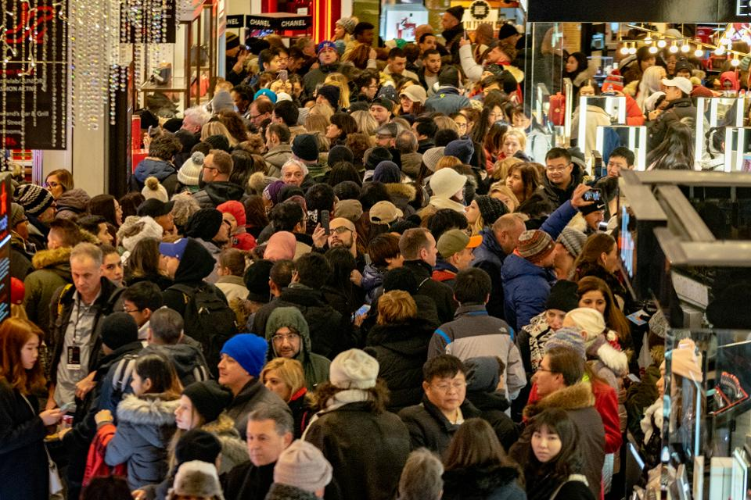
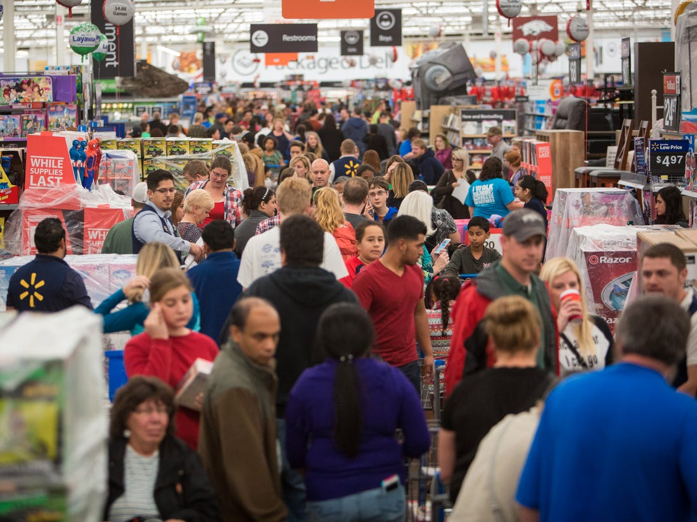
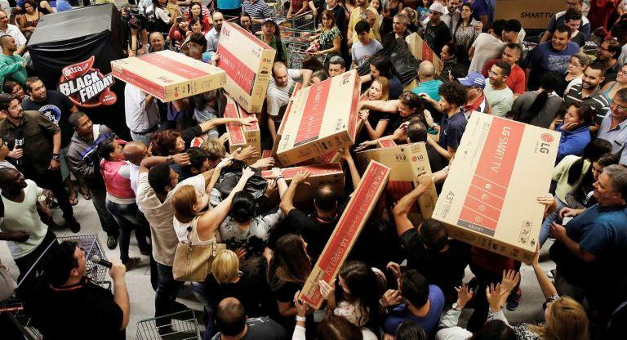
INTRODUCTION

Slide 5
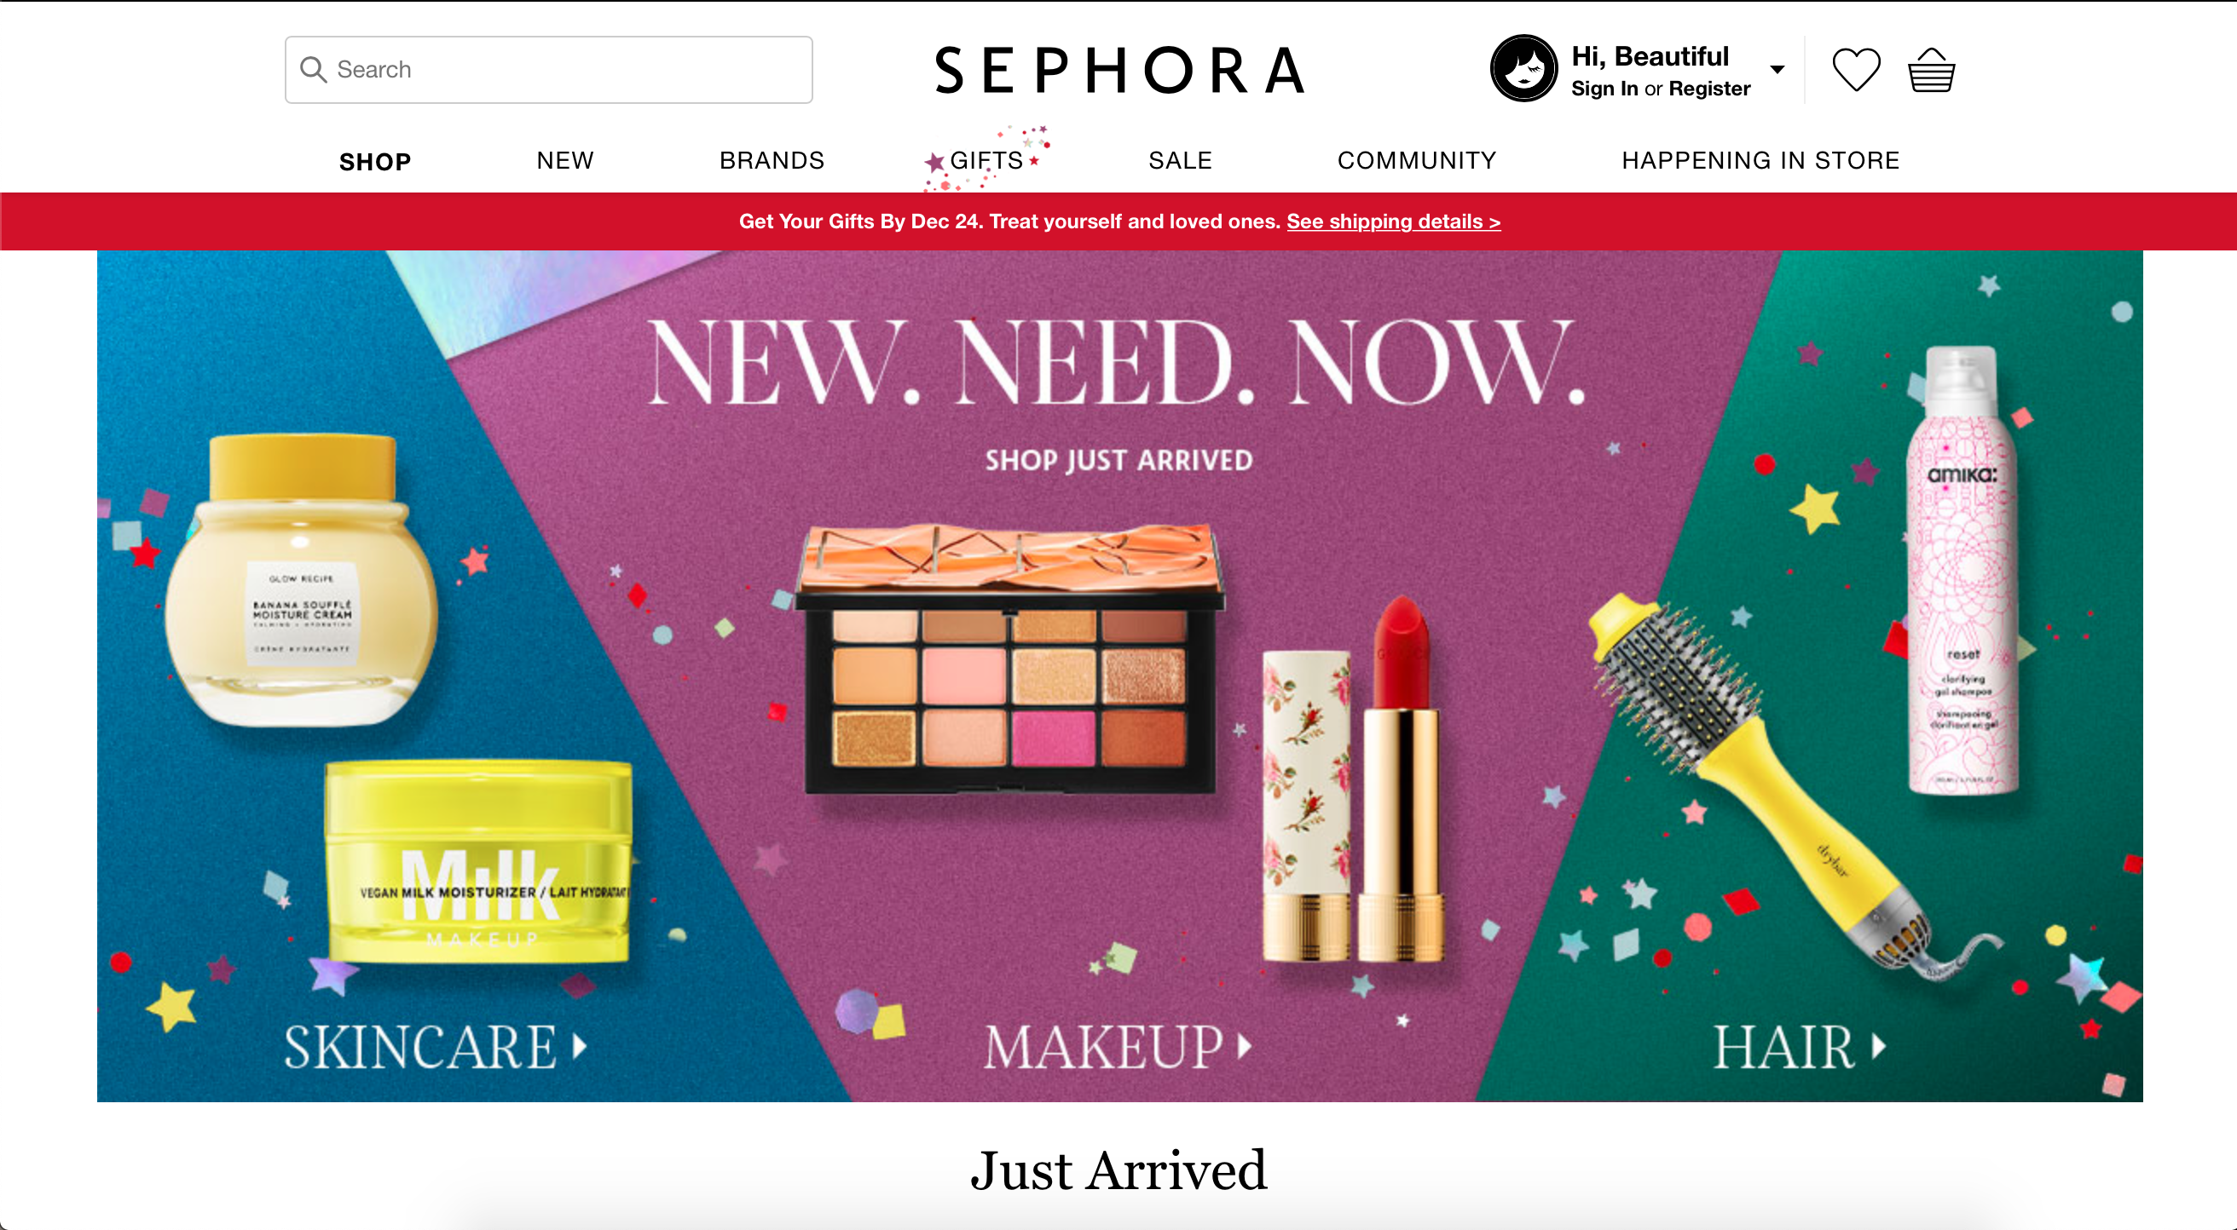
INTRODUCTION

Slide 6
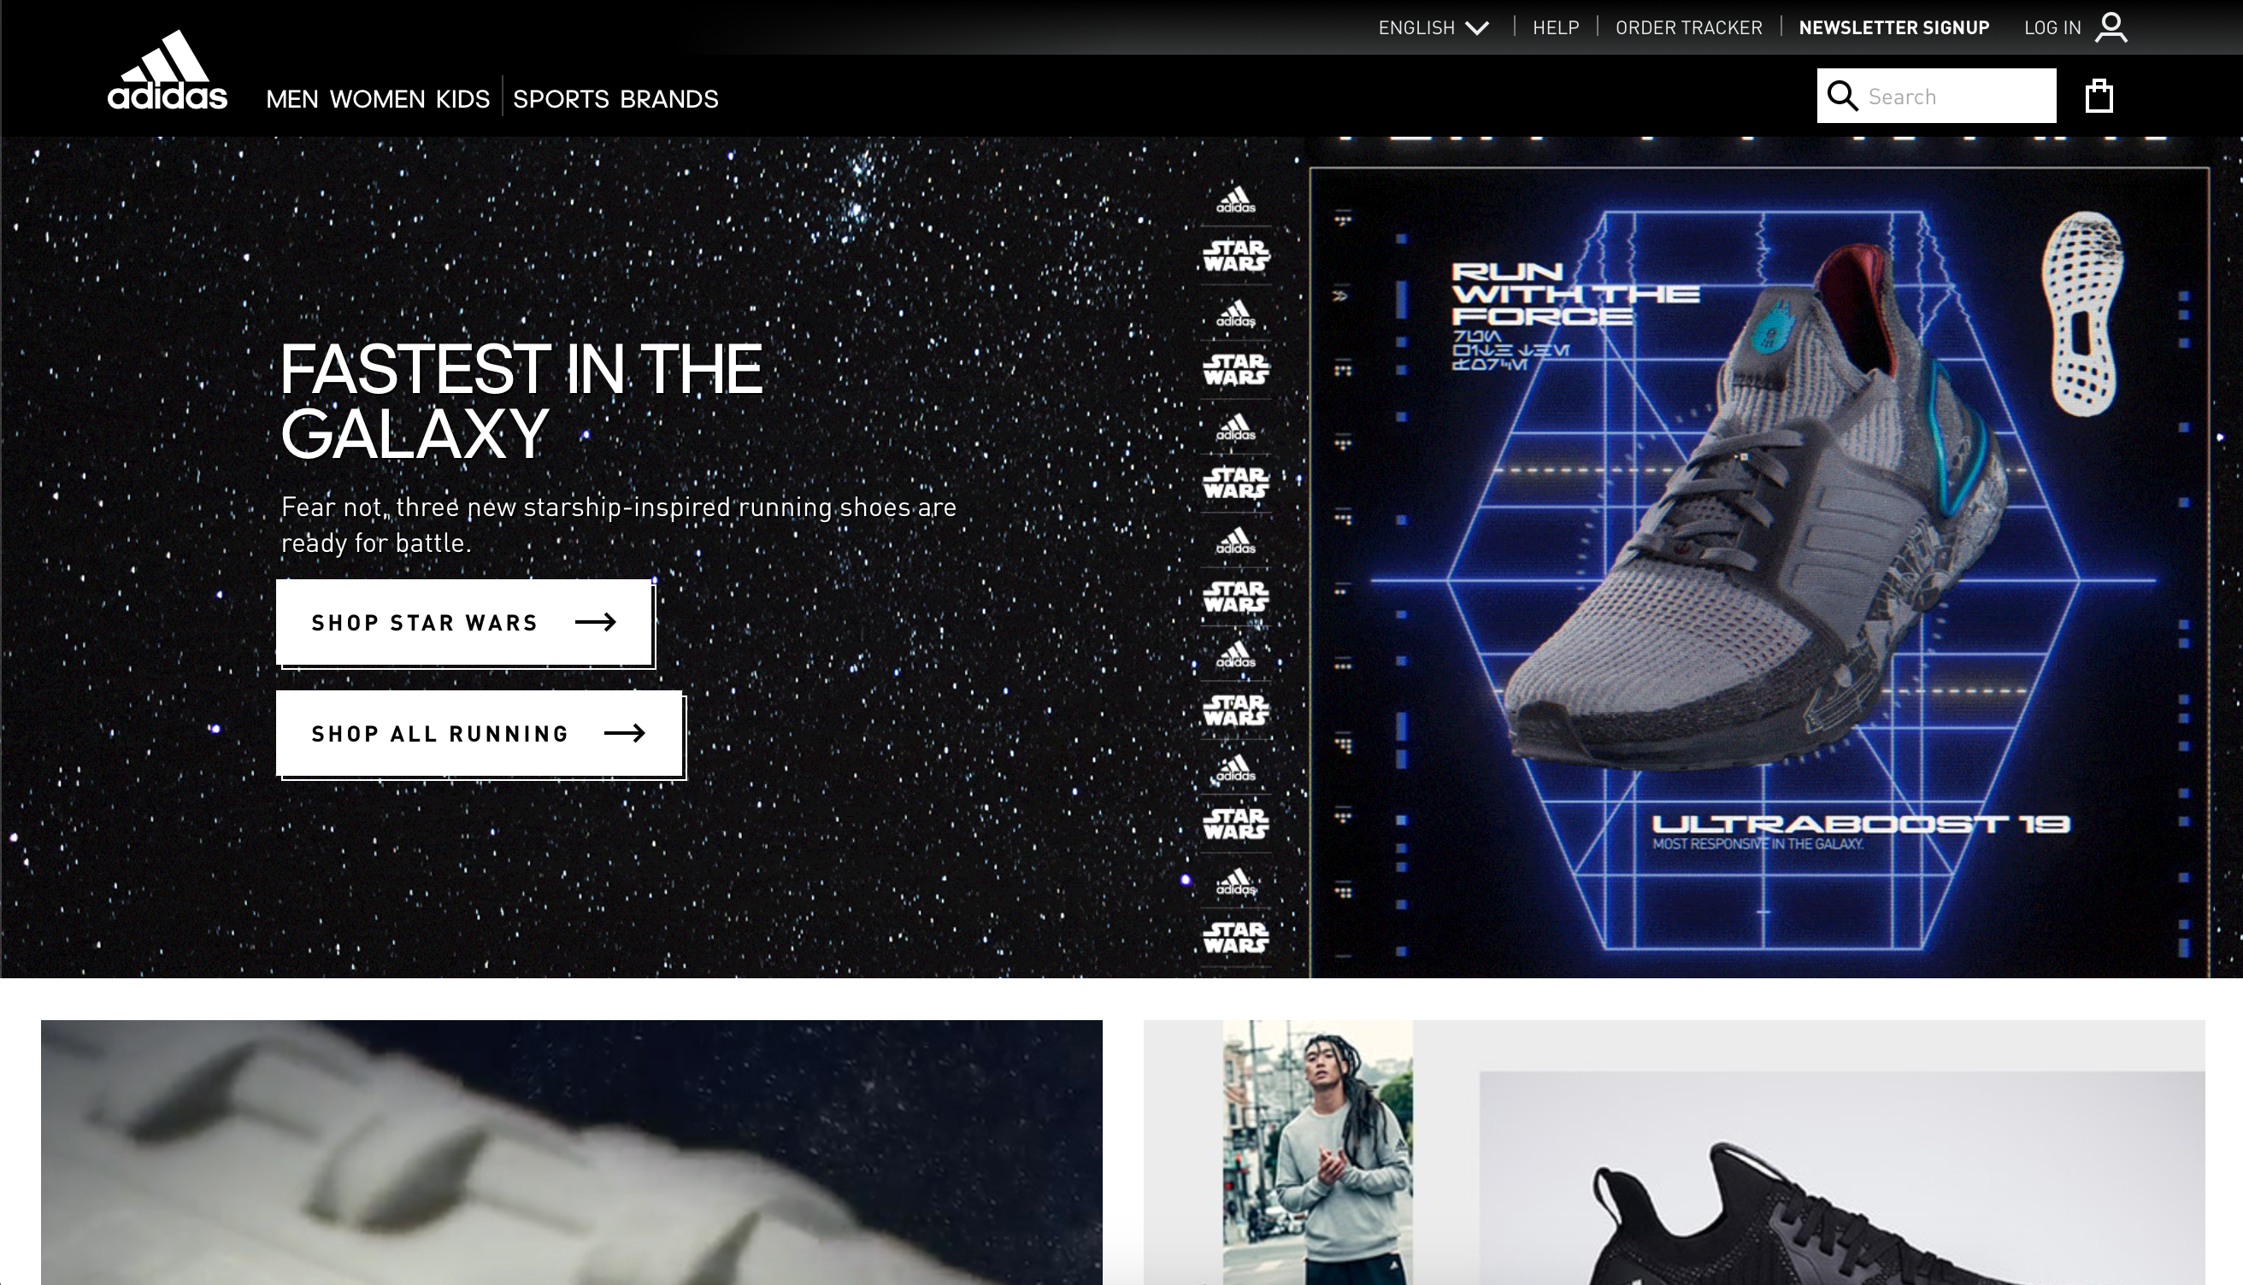
INTRODUCTION

Slide 7

INTRODUCTION

Slide 8
BACKGROUND
01
02
03
HI-TECH
WORK BURDEN
OVERLOAD
Modern technology has been greatly developed
Everyone is immersed in heavy workload
Shopping malls are being overloaded

Slide 9
GOALS
01
CONVINIENCE
02
TIME SAVING
03
MONEY SAVING
Deliverable, buy more, variable categories
Effortless performance
Promotion campaign, reduce traveling expense

Slide 10
02
ERD

Slide 11
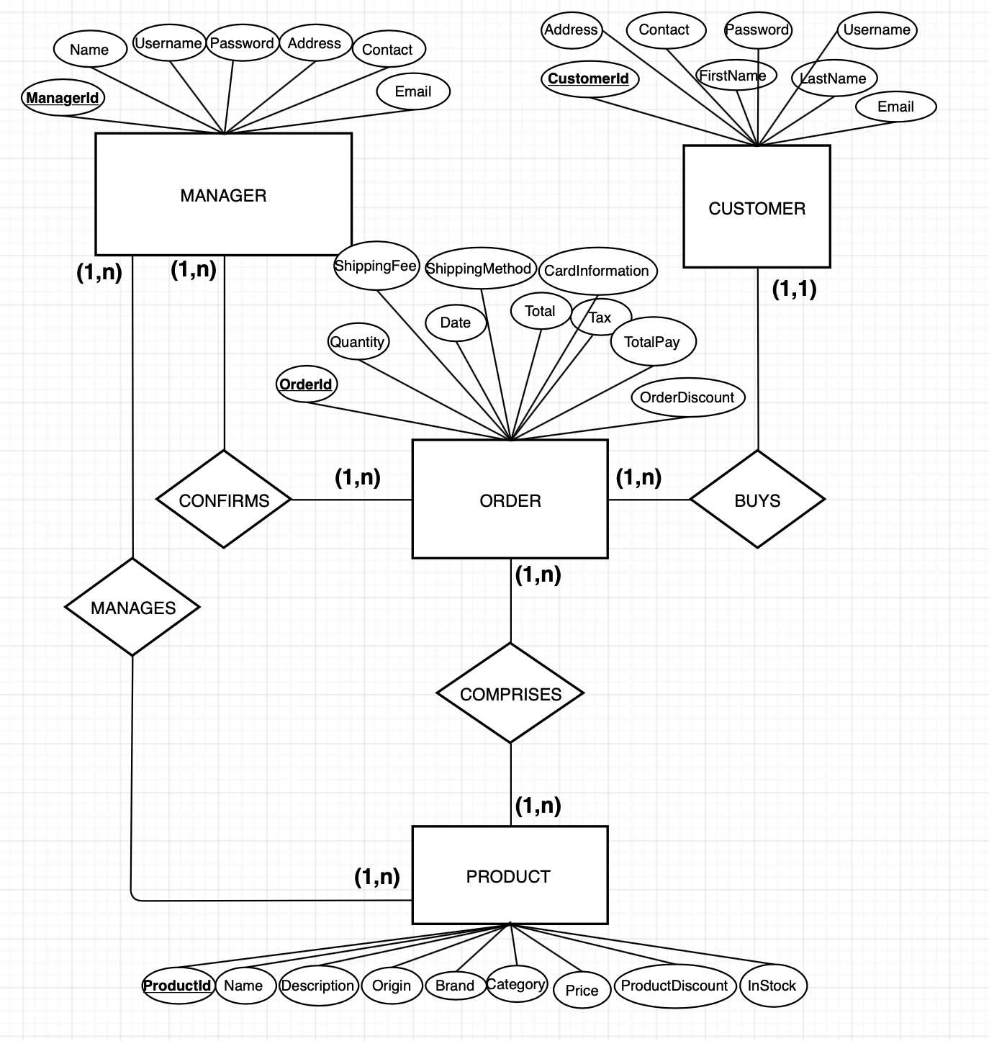
ERD MODEL

Slide 12
ERD MODEL EXPLANATION
Manages
Buys
RELATIONSHIP
Manager
Customer
Confirms
Comprises
ENTITY
Product
Order

Slide 13
MODEL-VIEW-CONTROLLER (MVC)

Slide 14
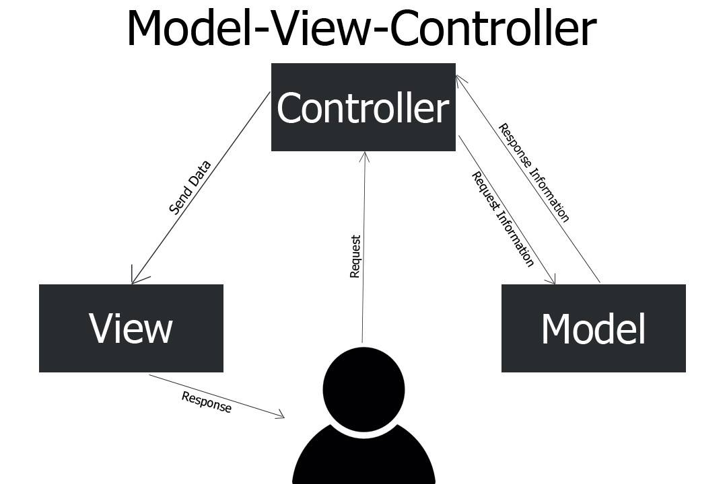
MVC

Slide 15
03
USE CASES

Slide 16
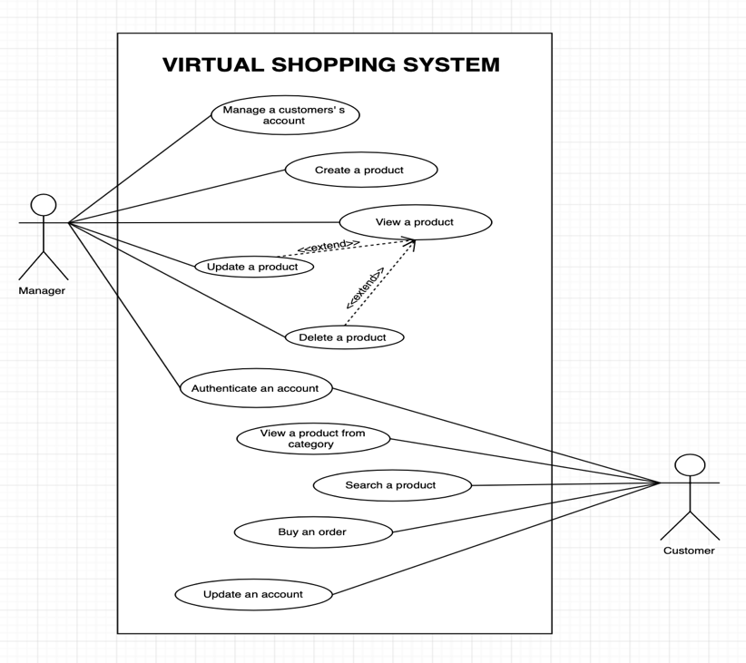
USE CASES

Slide 17
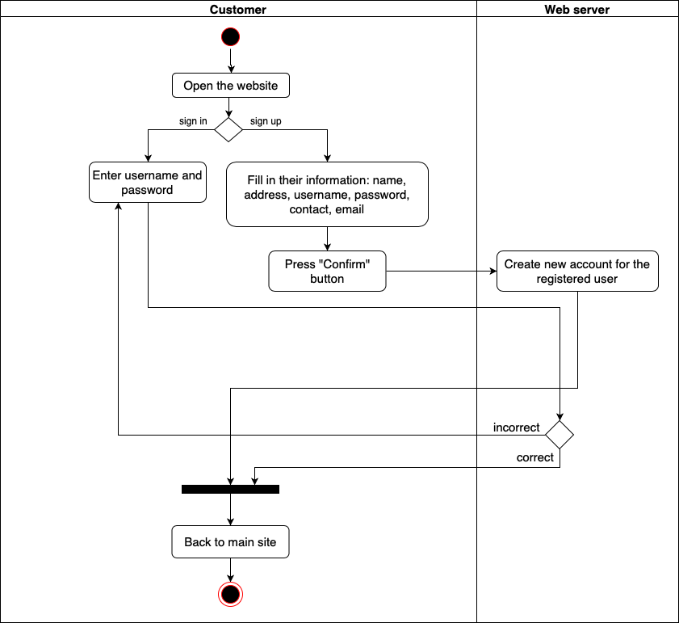
ACTIVITY DIAGRAM
Authenticate an account

Slide 18
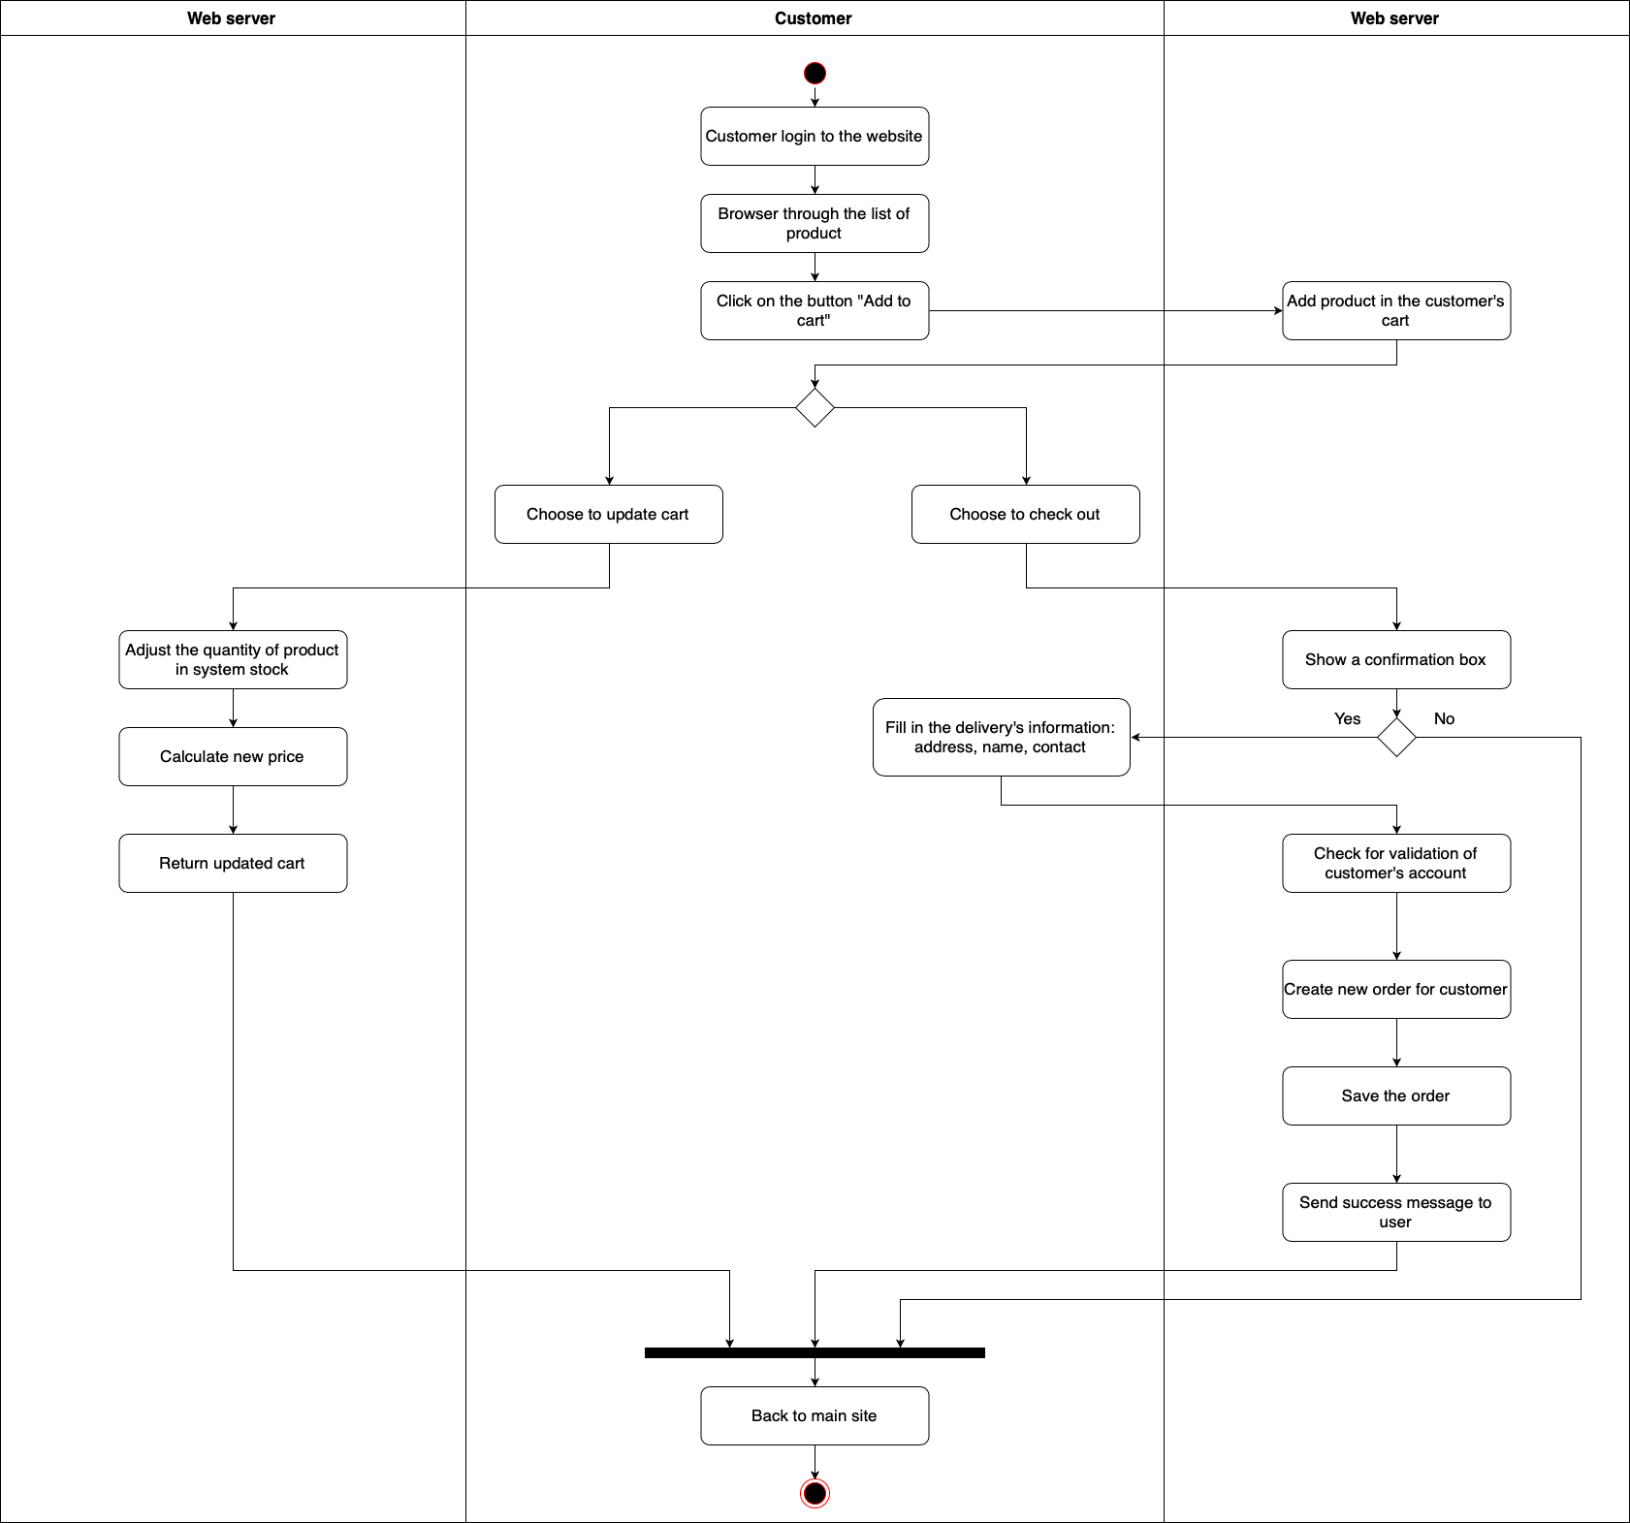
ACTIVITY DIAGRAM
Buy a product

Slide 19
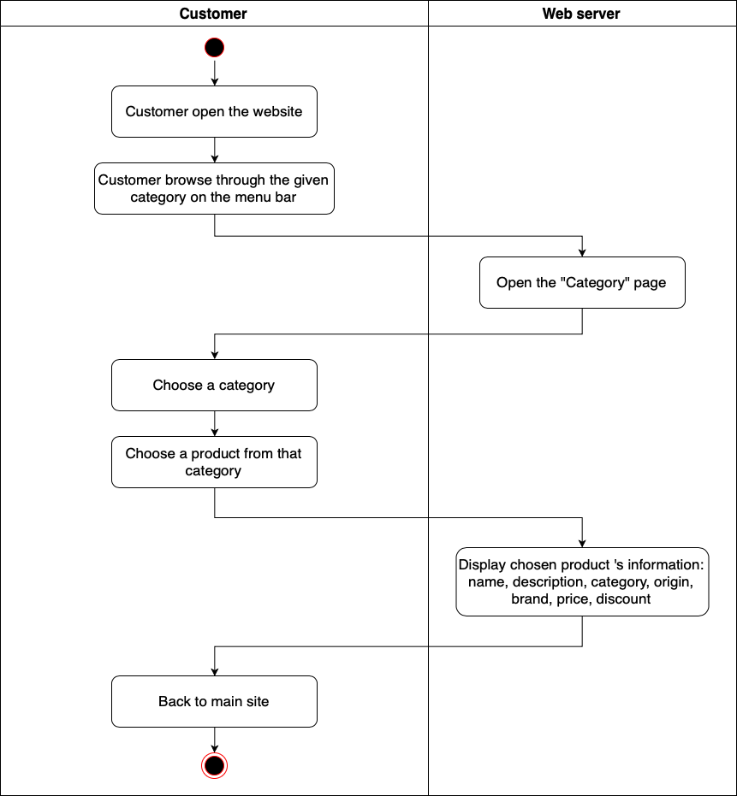
ACTIVITY DIAGRAM
Create a product

Slide 20
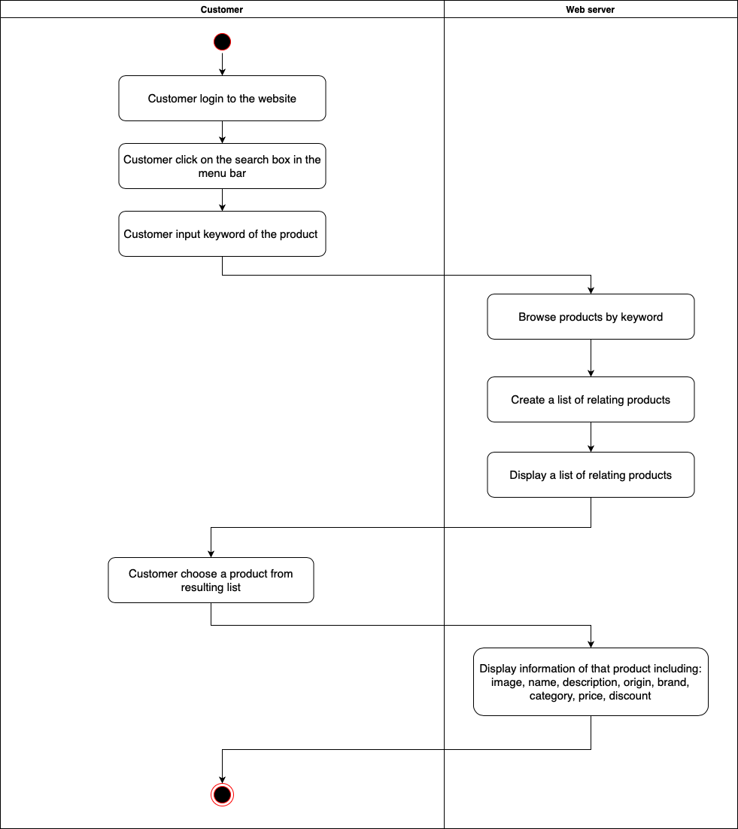
ACTIVITY DIAGRAM
Search a product

Slide 21
ACTIVITY DIAGRAM
View a product from category

Slide 22
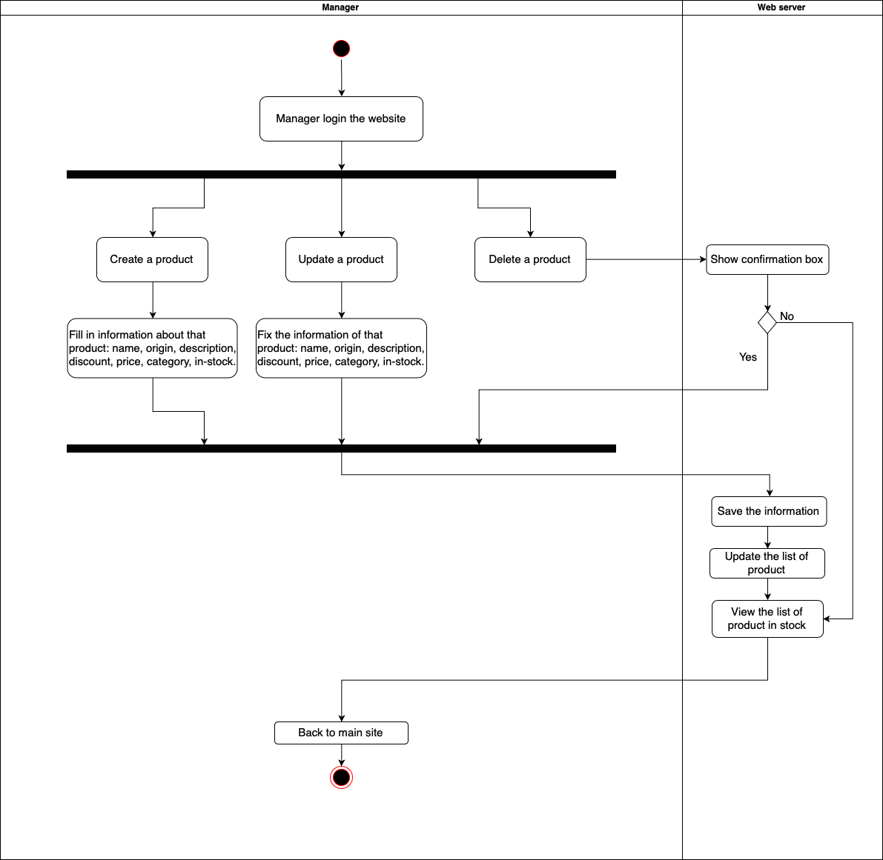
ACTIVITY DIAGRAM
Manage a product

Slide 23
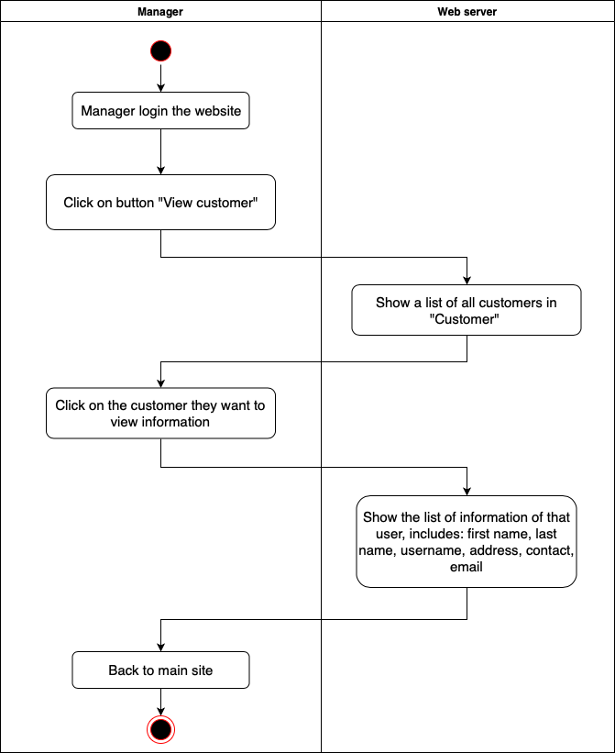
ACTIVITY DIAGRAM
Manage a customer’s account

Slide 24
04
IMPLEMENTATION

Slide 25
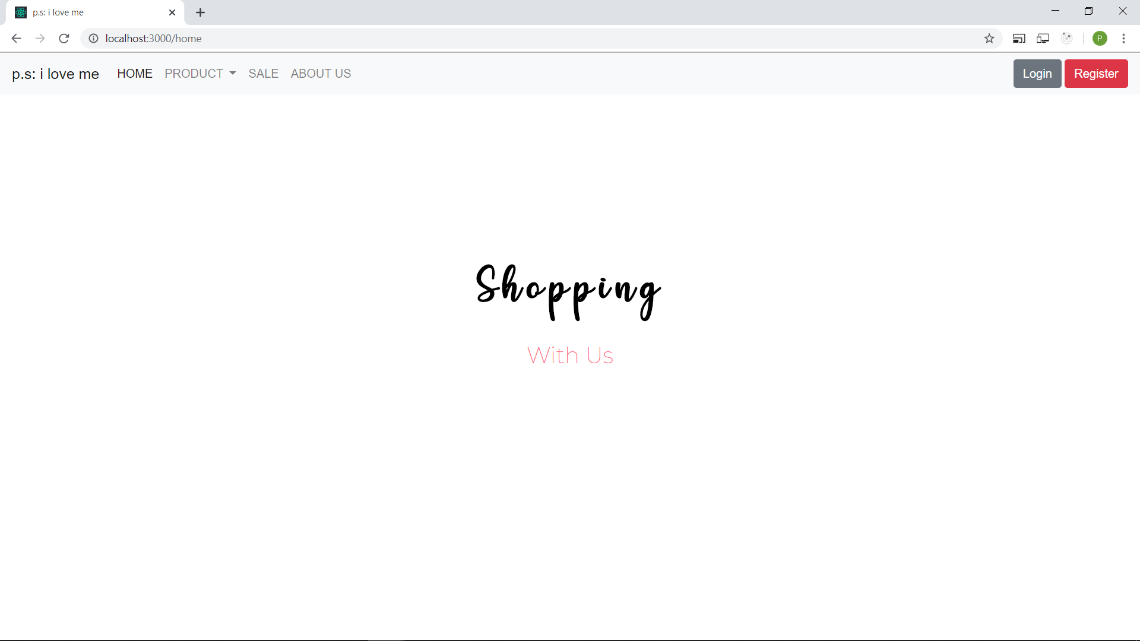
04
IMPLEMENTATION

Slide 26
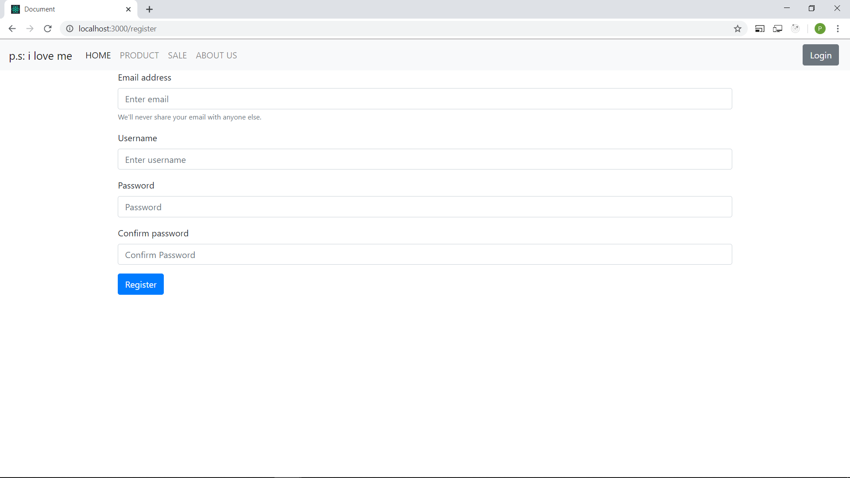
04
IMPLEMENTATION

Slide 27
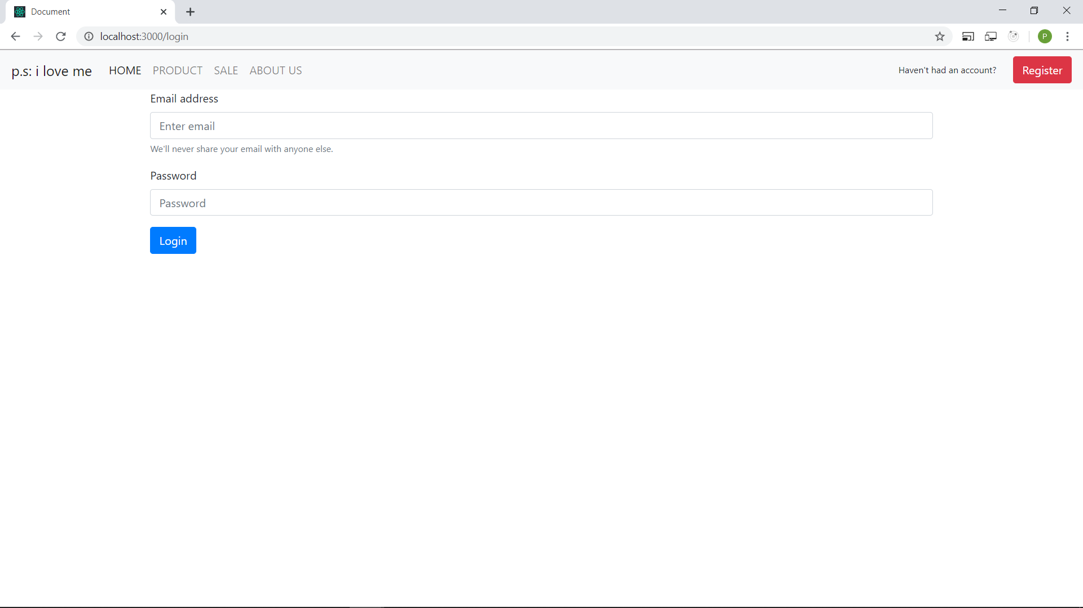
04
IMPLEMENTATION

Slide 28
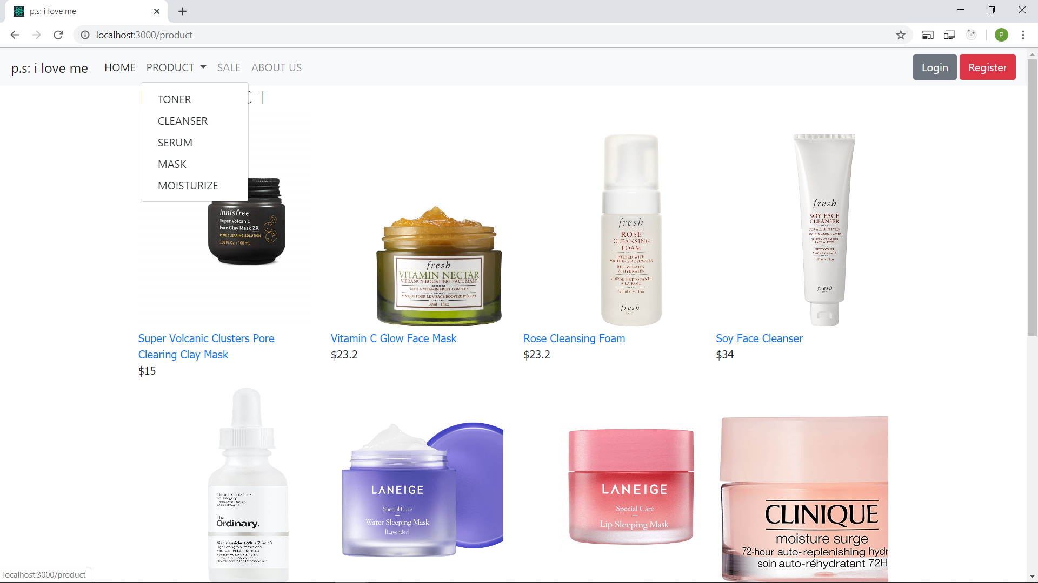
04
IMPLEMENTATION

Slide 29
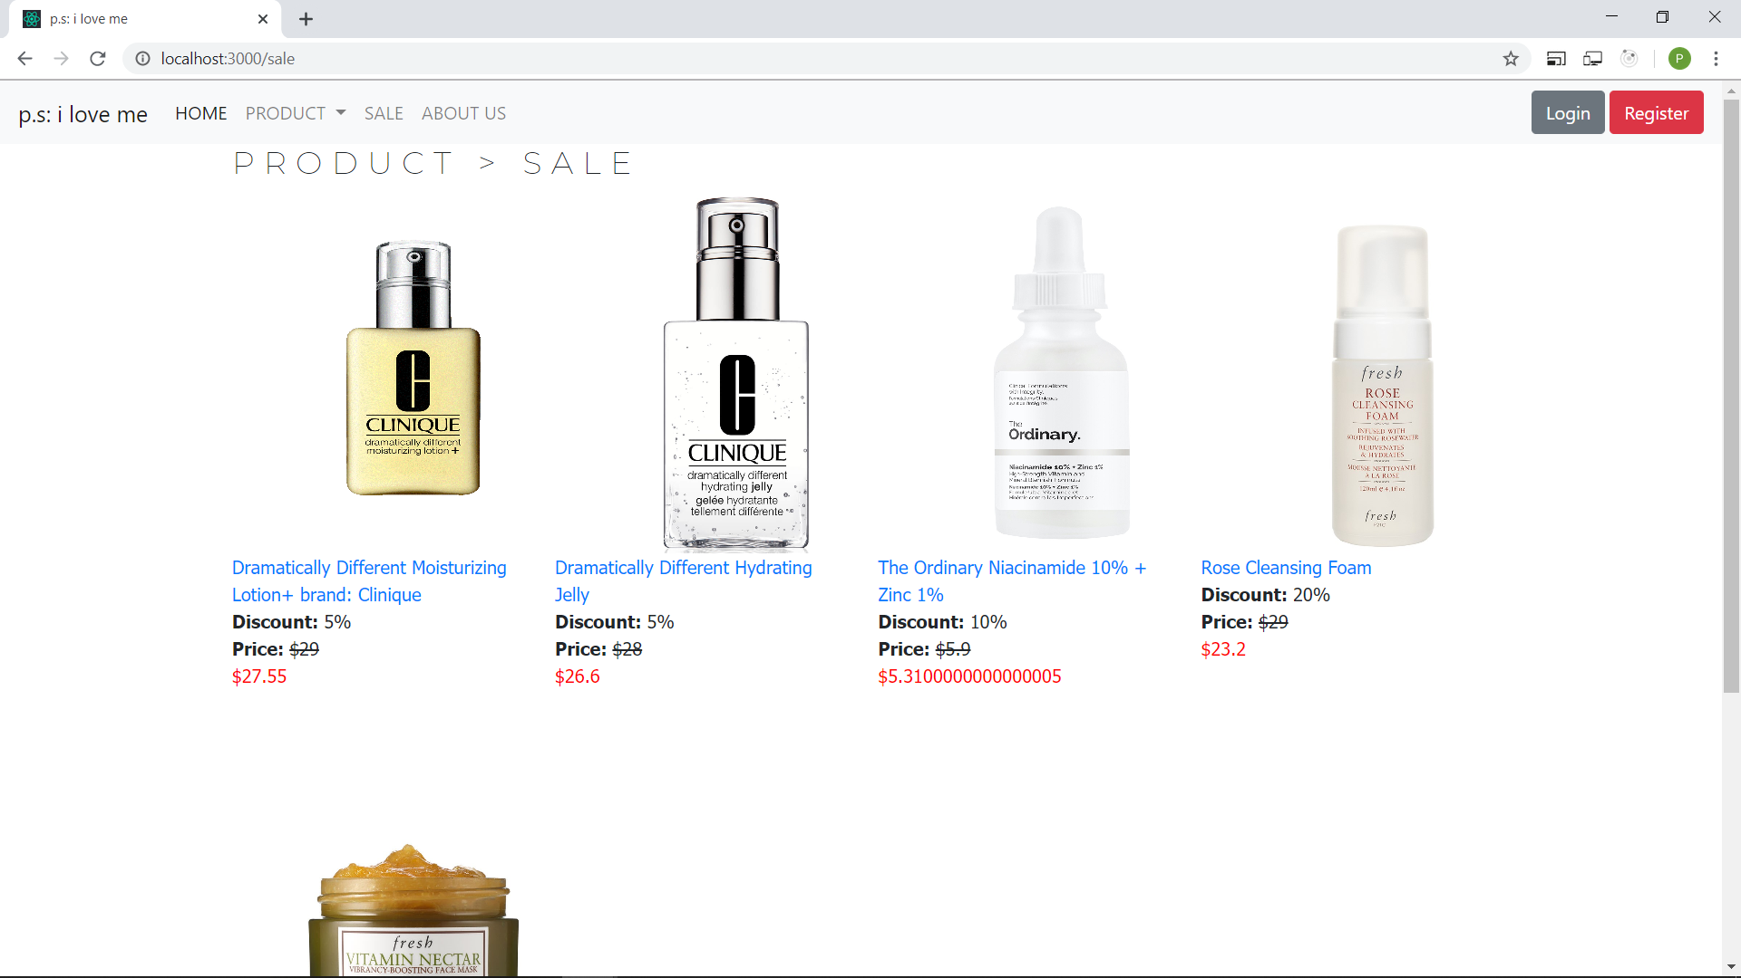
04
IMPLEMENTATION

Slide 30
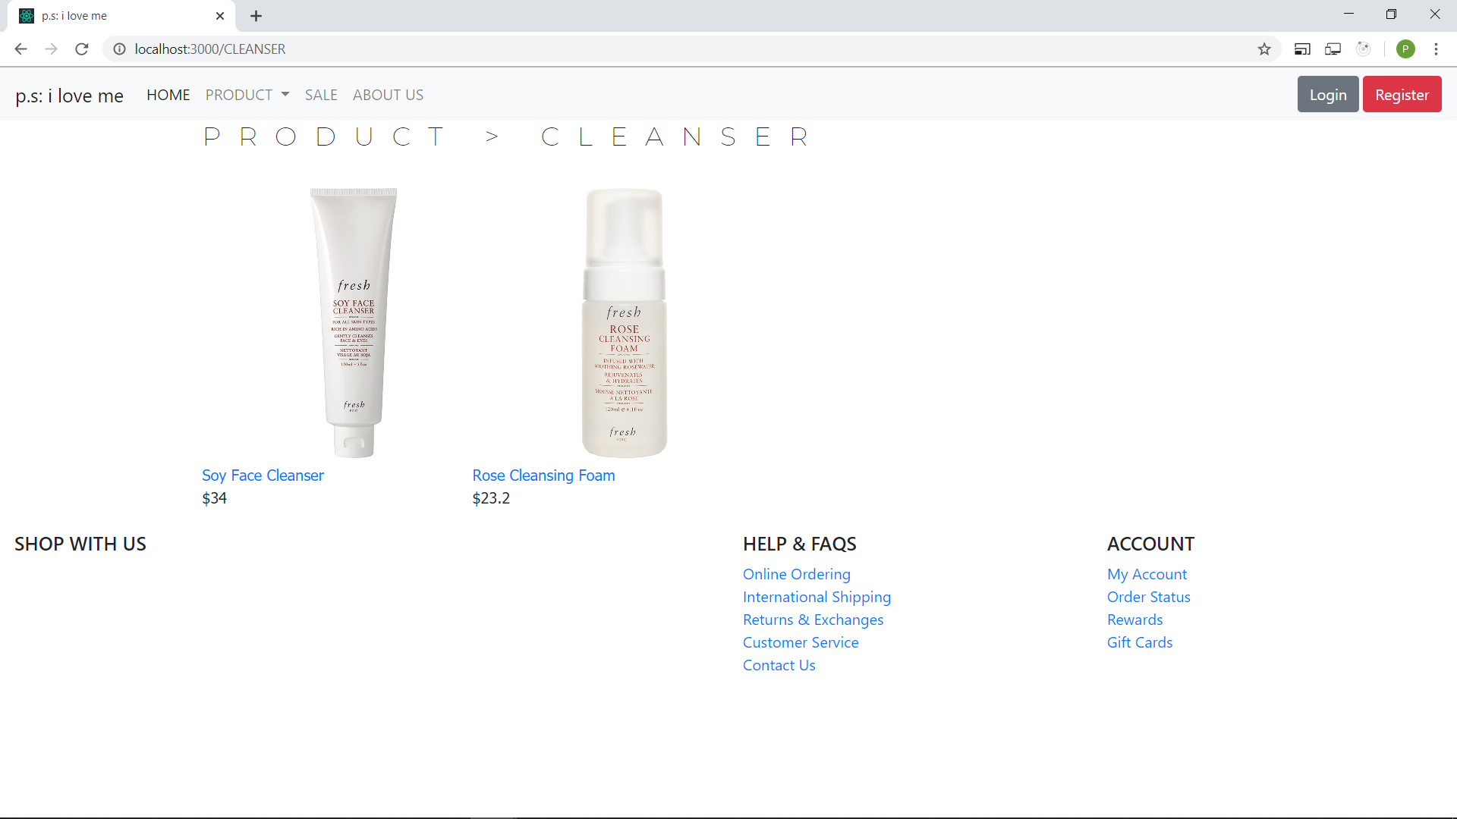
04
IMPLEMENTATION

Slide 31
THANKS
Do you have any questions?

Slide 32
REFERENCES
https://www.businessinsider.com/when-to-shop-to-avoid-crowds-2017-11
https://www.forbes.com/sites/joanverdon/2019/09/24/the-10-busiest-shopping-days-at-stores-does-anyone-still-care/
https://getitim.com/blogs/news/black-friday-shopping-online-vs-offline-shopping
https://www.sephora.com
http://www.innisfree.com/ca/en/main/index.do
https://www.adidas.com.vn/en
https://medium.com/datadriveninvestor/model-view-controller-mvc-75bcb0103d66

